Slide 1





yummy! Under supervision: Dr. Doaa Saleh

Slide 2

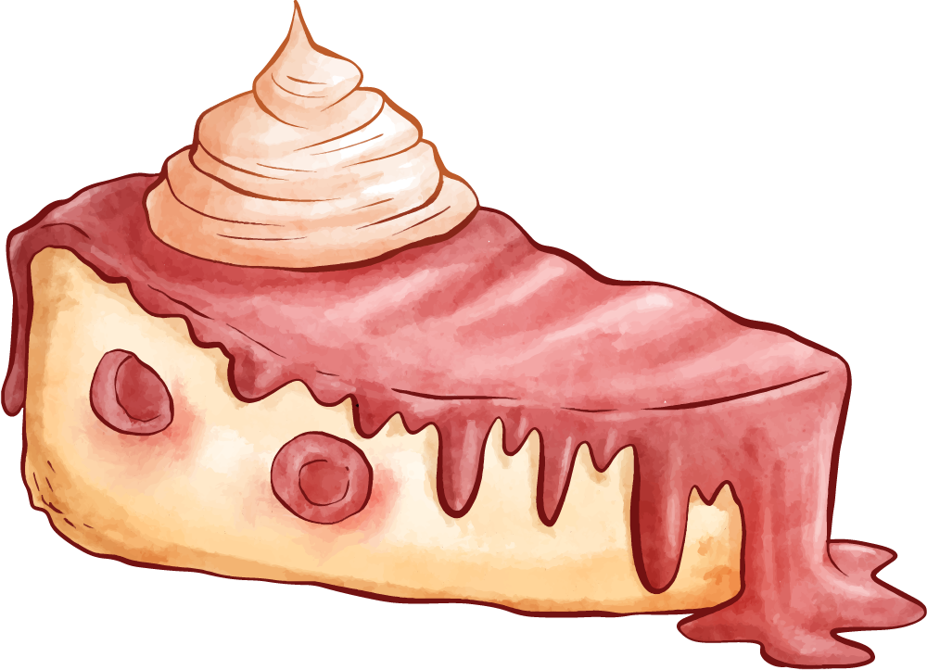
Introduction
A start up project of desserts and patisseries brand
This app will make easy for you of ordering your dessert
Remember that dessert always comes first

Slide 3


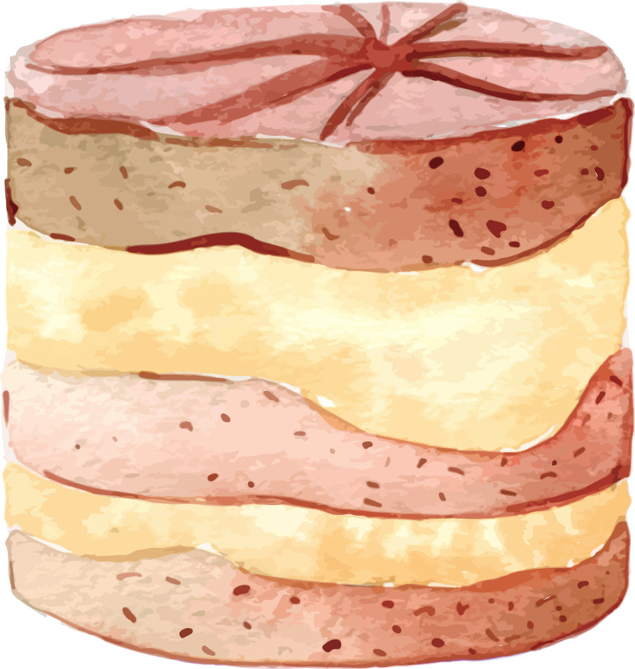
.
Get started!

Slide 4

Planning Function..
Organization objectives
List of alternatives
Rules of employees in our organization
Develop plans for purpose choose alternative

Slide 5


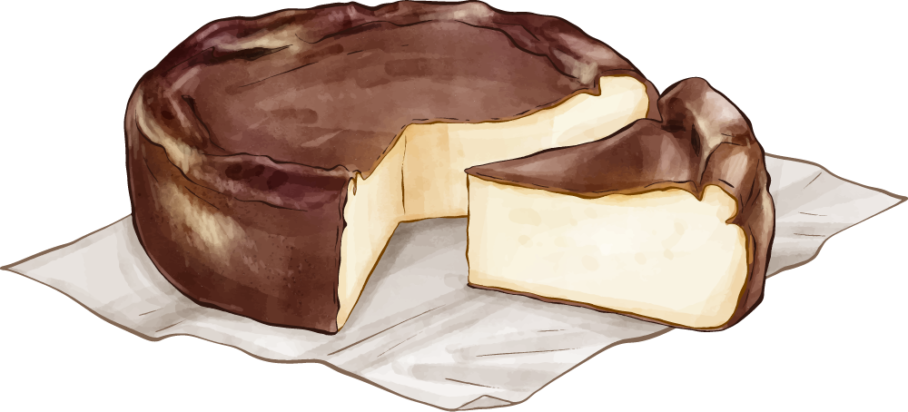

Sweet desserts!
Chocolate Cake
Lychee Cake
.
.

Slide 6

Organizing Function..
Divide major tasks into subtasks
- shipping
- Storage
- Cooking food
- Customer service
Allocate resources and directives for subtasks
Evaluate results of organizing strategy
Reflect on plans and objectives
Establish major tasks

Slide 7

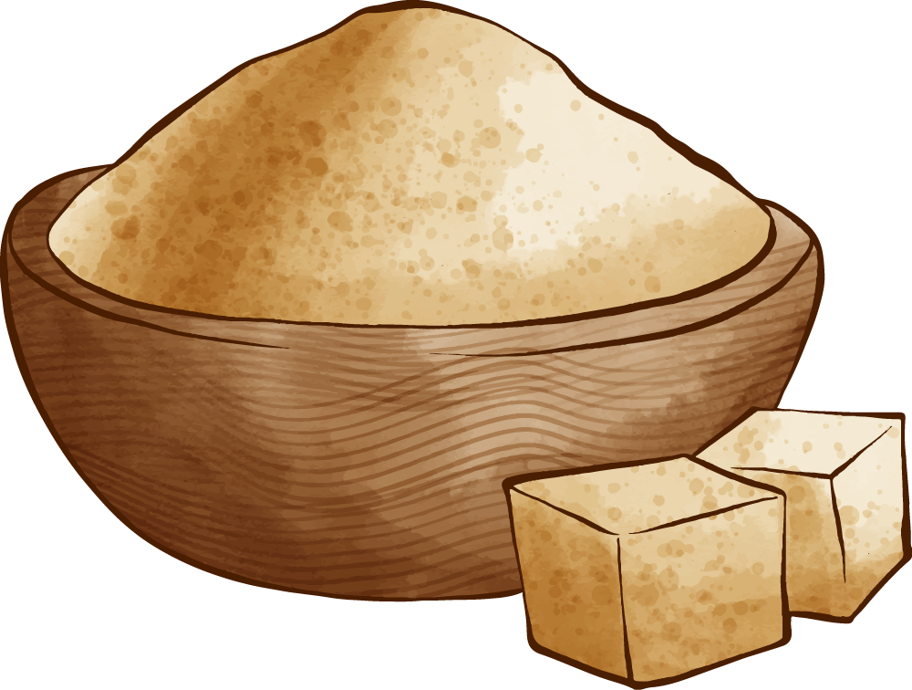


Basque cheesecake
Flour
Cane sugar
Butter
Cream cheese

Slide 8

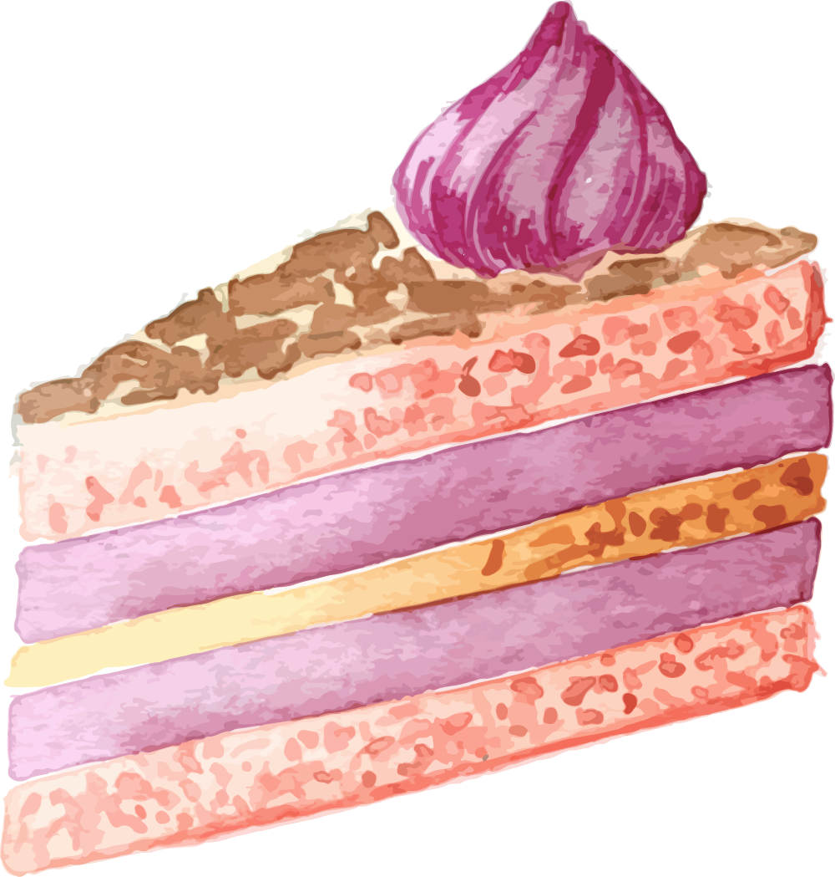
Infleuncing-Communication
Communication and interpersonal communication
Effective communication based on six principles
1. Establish a Warm Atmosphere.
2. Actively Engage People’s Interests.
3. Be Believable.
4. Speak with Your Voice.
5. Use Gestures Well.
6. Remember That Your Knowledge Is limited.

Slide 9




Banana smoothie ingredients
Banana
Sugar
.
…..
Oatmeal
Almond milk
.
.

Slide 10

Influencing-Communication
Successful Communication
Unsuccessful Communication
Feedback
-Verbal Feedback
-Non-verbal Feedback

Slide 11
Influencing-Leadership
Leadership
Leadership
Leadership definition
process
property

Slide 12
Controlling..
Analyzing deviations
-Critical point control
-Management by exception
The Importance of controlling
Corrective actions if needed

Slide 13
Thanks!
Does anyone have any questions?
Yummy6063@gmail.com
+91 620 421 838
Yummy.com

Slide 14
Prepared by
Team Members | ID
Nourhan Amr Abd El Wahab Fathy | 20201203
Aya Hasanin Sayed Abd elmaged Ayad | 20201041
Donia Ahmed Abozeid Mohammed | 20201060
Hager Mohamed Abdelhalim | 20201206
Nada Mohamed Ahmed Gad Elkareem | 20201191
Suhaila Mahmoud Mohamed | 20200235
Zeinab Ali Ahmed | 20201083
Razan Abu Bakr | 20200775

